Slide 1
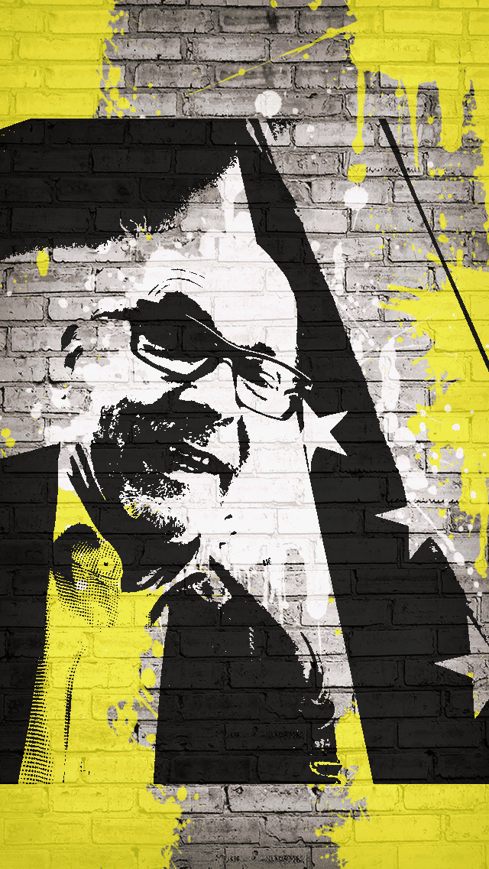
Democracy, human rights, and the rule of law by design for artificial intelligence by Paul Nemitz , Principal Adviser, European Commission
@paulnemitz
#AI

Slide 2
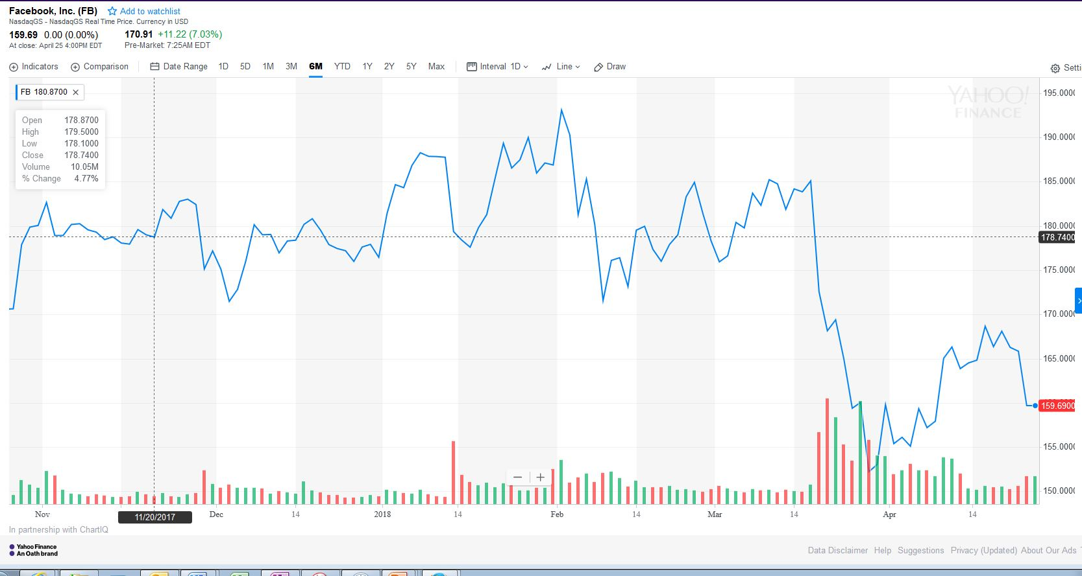

Slide 3
The Geostrategy of Artificial Intelligence
 | U.S.A | E.U. | China
MARKET SITUATION FOR MAJOR AI SYSTEM INTEGRATION | OLIGOPOLY |  | OLIGOPOLY
CONTROL OF PERSONAL DATA | CORPORATE | INDIVIDUALS BASED ON GDPR | GOVERNMENT CONTROLS PEOPLE THROUGH SCORING
REGULATION | SELF REGULATION ETHICS CODES | PARLIAMENTARY LAW BASED ON ETHICS AND FUNDAMENTAL VALUES | GOVERNMENT

Slide 4
Values set out in Art. 2 of the Treaty on European UNion
Article 2
The Union is founded on the values of respect for human dignity, freedom, democracy, equality, the rule of law and respect for human rights, including the rights of persons belonging to minorities. These values are common to the Member States in a society in which pluralism, non-discrimination, tolerance, justice, solidarity and equality between women and men prevail.

Slide 5
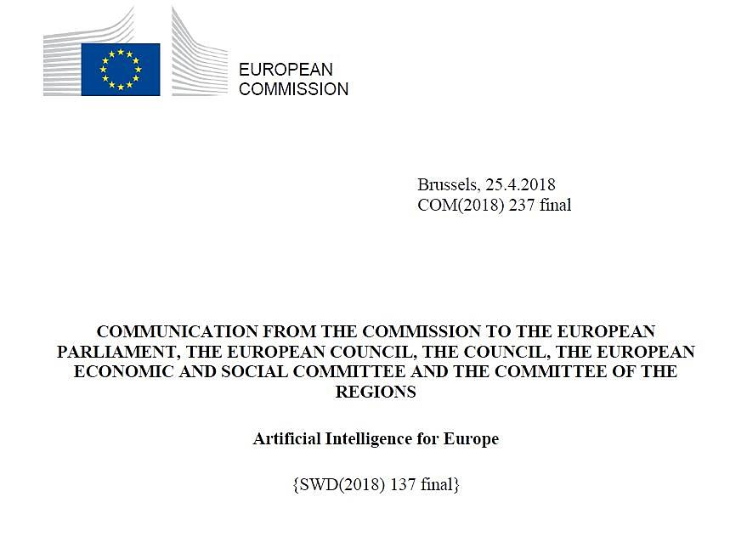

Slide 6
Chapter 3.3. Ensuring an appropriate ethical and legal framework
[…] "This is essential as citizens and businesses alike need to be able to trust the technology they interact with, have a predictable legal environment and rely on effective safeguards protecting fundamental rights and freedoms. " […]

Slide 7
EU Charter of Fundamental Rights
EU Standards in terms of safety and product liability
EU Rules on network and information systems security
EU Rules on protection of personal data
The General Data Protection Regulation (GDPR)
Limits to decision-making based solely on automated processing and profiling (Art.22)
Right to be provided with meaningful information about the logic involved in the decision ( Art.13 (2) f. and 15 (1) h)

Slide 9
Draft AI ethics guidelines
As a first step to address ethical concerns, draft AI ethics guidelines will be developed bythe end of the year, with due regard to the Charter of Fundamental Rights of the European Union.
The draft guidelines will address issues such as the
Future of work
Fairness
Safety
Security
Social inclusion and
Algorithmic transparency

Slide 10
Draft AI Ethics guidelines
Impact on fundamental rights:
Privacy
Dignity
Consumer protection
Non-discrimination

Slide 11
Ethics guidelines will build on :
European Group on Ethics in Science and New Technologies statement on AI
other similar efforts - Alan Wienfield's list of AI ethics codes
Companies, academic institutions, and other organisations from civil society bodies will be invited to contribute.
In parallel, the Commission will continue its work towards progress on ethics at international level. The European Commission's International Dialogue on Bioethics and Ethics in Science and New Technologies brings together the National Ethics Councils of EU Member States and of third countries, to work together on those matters of common concern.

Slide 13
Safety
[…] Given AI's widespread uses, both horizontal and sectoral rules may need to be reviewed.
The EU safety framework already addresses the intended use and foreseeable (mis)use of products when placed on the market. This has led to the development of a solid body of standards in the area of AI-enabled devices that is continuously being adapted in line with technological progress..
The further development and promotion of such safety standards and support in EU and international standardisation organisations will help enable European businesses to benefit from a competitive advantage, and increase consumer trust. Standards also cover interoperability, which is crucial for offering consumers greater choices and ensuring fair competition. […]

Slide 14
Alan WinField's List of Ethics Codes
Asimov's three laws of Robotics (1950)
Murphy and Wood's three laws of Responsible Robotics (2009)
EPSRC Principles of Robotics (2010)
Future of Life Institute Asilomar Principles for beneficial AI (Jan 2017)
The ACM US Public Policy Council Principles for Algorithmic Transparency and Accountability (Jan 2017)
Japanese Society for Artificial Intelligence (JSAI) Ethical Guidelines (Feb 2017)
Draft Principles of the Future Society's Science, Law and Society Initiative (Oct 2017)
Montréal Declaration for Responsible AI draft principles (Nov 2017)
IEEE General Principles of Ethical Autonomous and Intelligent Systems (Dec 2017)
UNI Global Union Top 10 Principles for Ethical AI (Dec 2017)

Slide 15
European Group on Ethics in Science and New Technology (EGE) Statement on Artificial Intelligence, Robotics and "Autonomous" systems
(9 March 2018)

Slide 16
Programmers –Implement !
Democracy, human rights, and the rule of law
by design in artificial intelligence

Slide 17
IF AI SETS the RULES LIKE A LAW…..
…..AI WILL HAVE TO BE CHECKED LIKE A LAW
In a Democratic Process
-Against Higher Law

Slide 18
Rule of Law v. Rule of AI
No action which is illegal if committed by a human can be legal if committed by AI

Slide 19
Google: It's not us, it is the Algorithm
Argument rejected by European Court of Justice in the Google Right to be forgotten Judgement
AI can neither lead to interrupt the chain of responsibility nor undermine rights of individuals

Slide 20
"by design" and "By Default" Art 25 §1 GDPR
FINES: UP TO 2% – AND IN REPEAT CASE UP TO 4% - OF WORLD TURNOVER
ART 83 GDPR

Slide 21
EU General Data Protection Regulation GDPR

Slide 22
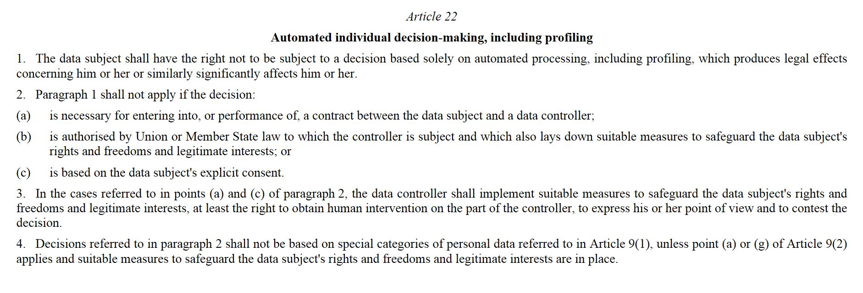
Art.22 GDPR

Slide 23
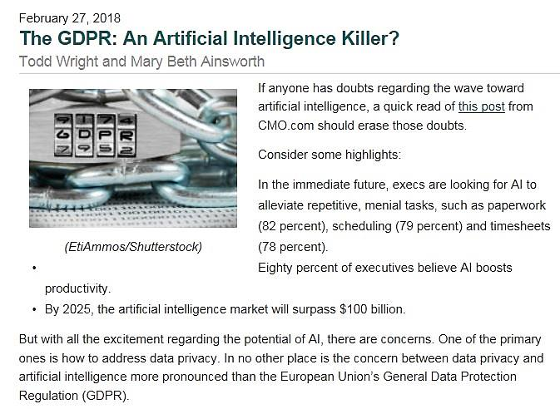

Slide 24
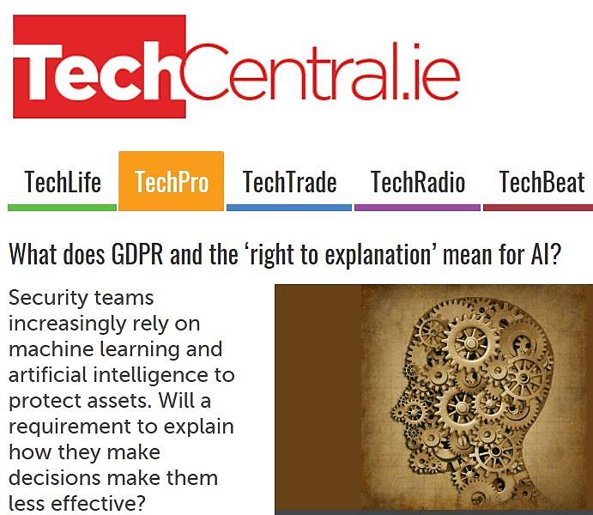

Slide 25
GDPR in America 2016 – 2017: Adaptation to EU GDPR Standards a priority for US companies

Slide 26
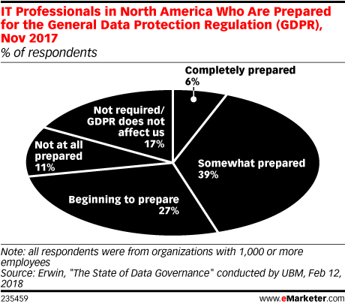
GDPR in America 2016 – 2017: Adaptation to EU GDPR Standards a priority for US companies

Slide 27
GDPR on its way to a global standard 2016 - 2018
Politico, Europe’s new data protection rules export privacy standards worldwide By Mark Scott and Laurens Cerulus
1/31/18, https://www.politico.eu/article/europe-data-protection-privacy-standards-gdpr-general-protection-data-regulation/

Slide 28
GDPR in America 2018 – Facebook – Cambridge Analytica desaster makes GDPR a global standard
Tech Crunch, April 2018, https://techcrunch.com/2018/04/04/zuckerberg-gdpr/

Slide 29
BIG NEWS: GDPR IS NOT ONLY ABOUT PRIVACY
GDPR APPLIES TO ALL AI WHICH PROCESSES PERSONAL DATA, THUS DATA WHICH IDENTIFIES A PERSON OR MAKES IT POSSIBLE TO IDENTIFY A PERSON.
THAT IS BIG !

Slide 30
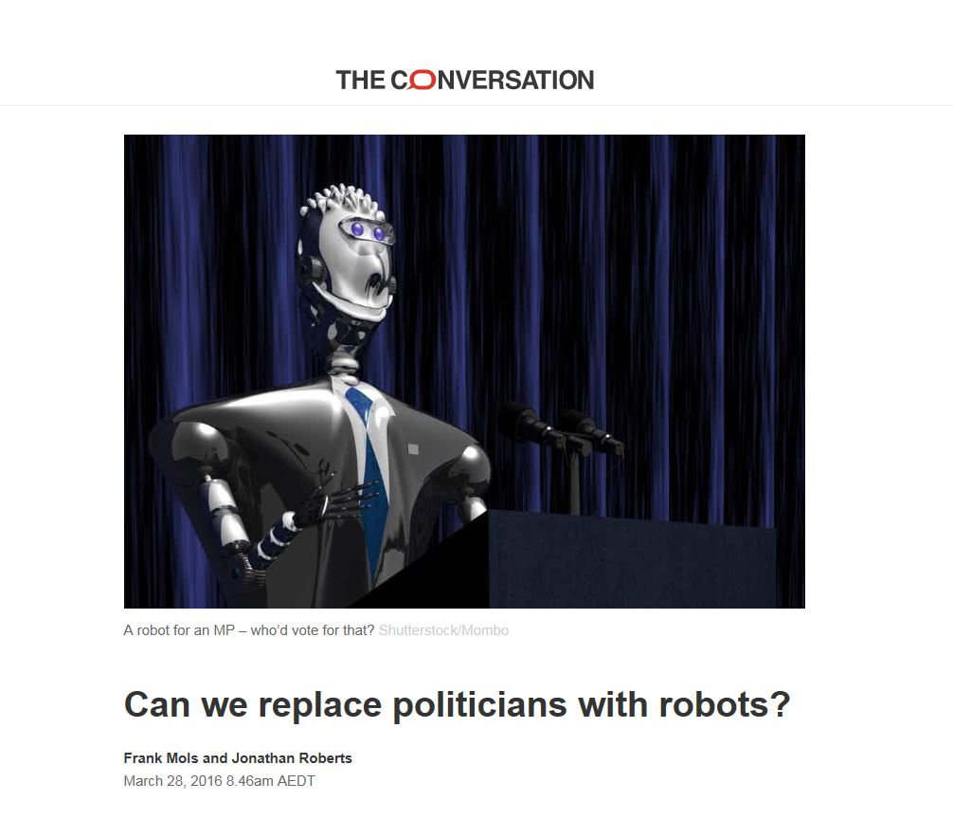

Slide 31
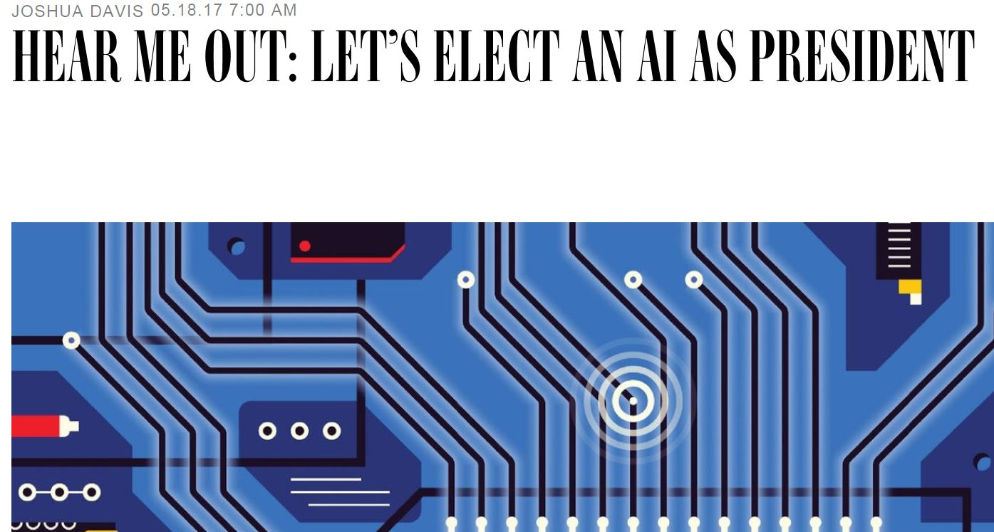

Slide 32
John Perry Barlow
Declaration of the independence of Cyberspace

Slide 33
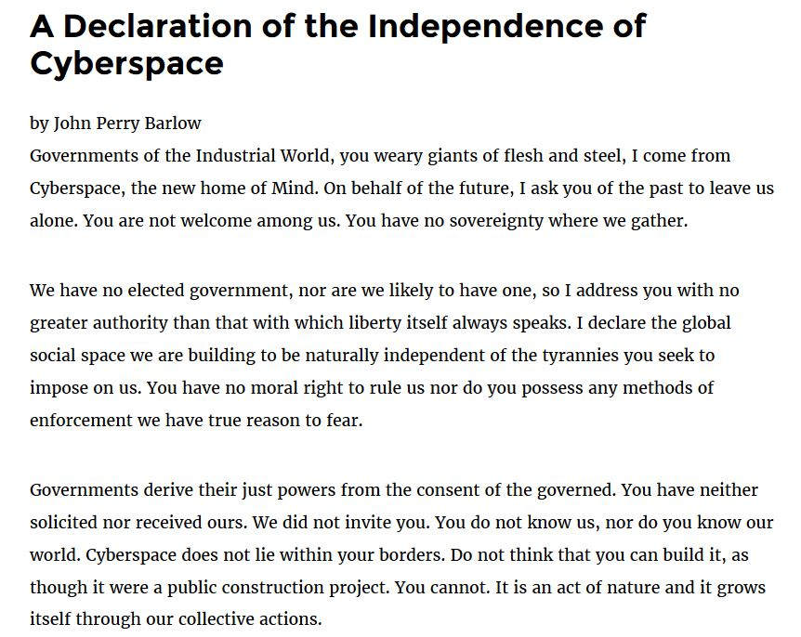
John perry BarLow (October 3, 1947 – February 7, 2018)

Slide 34
Obligation to give reasons
Art. 296 Treaty on the functioning of the European Union
Legal acts shall state the reasons on which they are based […]

Slide 35
Obligation to provide meaningful information - Art. 15 GDPR
Article 15
Right of access by the data subject
1. The data subject shall have the right to obtain from the controller confirmation as to whether or not personal data concerning him or her are being processed, and, where that is the case, access to the personal data and the following information:
[…]
(h)
the existence of automated decision-making, including profiling, referred to in Article 22(1) and (4) and, at least in those cases, meaningful information about the logic involved, as well as the significance and the envisaged consequences of such processing for the data subject.
[…]

Slide 36
Meaningful information and the right to explanation
Andrew D Selbst Julia Powles
International Data Privacy Law, Volume 7, Issue 4, 1 November 2017, Pages 233–242, https://doi.org/10.1093/idpl/ipx022
Published:
19 December 2017

Slide 37
The imagination and Criticism Gap of Ai
Problem Solution
Theory
Theory application in practice
Critical Review of practice based on imagination of the better
New ideas for better practice

Slide 38
HUME'S LAW:
"You can’t derive an ought from an is, moral conclusions from non-moral premises."

Slide 39
From Kant we Learn – Critical Thinking and the Categorical Imperativ

Slide 40
Thank you ! Be in Touch ! Talk with Europe ! About AI !
#AI
#Europe
@paulnemitz paul.nemitz@ec.europa.eu

